Slide 1
Using Machine Learning to Project Individual OPS for MLB Players
Daniel Brilliant
DATA602 Spring 2023

Slide 2
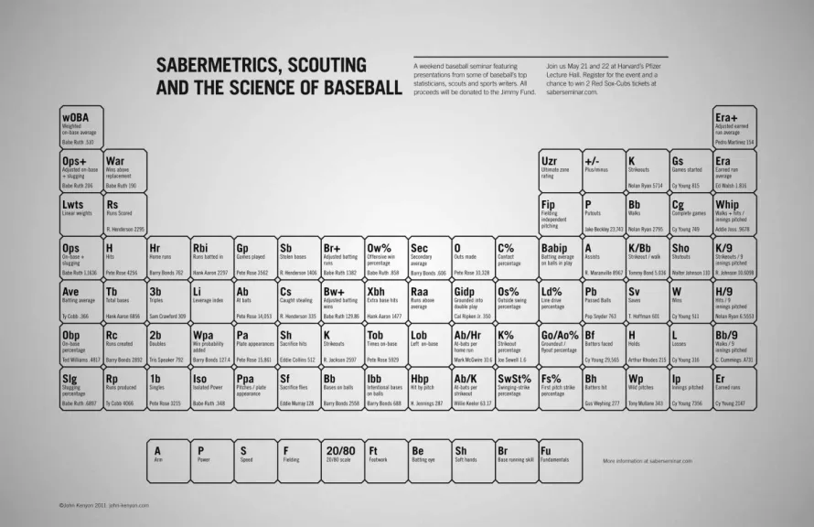
Background
Baseball analytics have existed for decades now, in the form of sabermetrics
Sabermetrics is the search for objective baseball knowledge through statistical analysis
Public sabermetric research began in 1982 when Bill James published his ideas in the Bill James Baseball Abstract.
Public baseball research has grown and expanded over the years, leading to the formation of SABR (the Society of American Baseball Research) and implementation of sabermetric research and analytics departments on every MLB team by the mid-2010s
MLB team implementation of analytics forefronted by Billy Beane and the Oakland Athletics in the early 2000s, as chronicled by the Michael Lewis book Moneyball
Image from: https://brewmaths.com/sabermetric-table-of-elements/

Slide 3
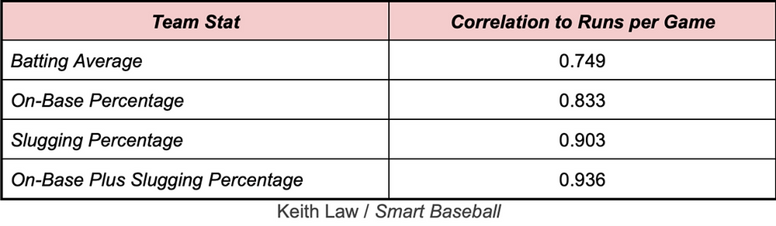
What is OPS?
OPS = On base percentage (O) Plus (P) slugging percentage (S)
On base percentage (OBP) is how often a player reaches base, calculated by the sum of hits, walks, and times hit by pitch divided by the sum of at bats, walks, times hit by pitch, and sacrifice flies
Slugging percentage (SLG) is the number of total bases divided by the number of at bats. Total bases are calculated by multiplying each hit by the amount of bases are taken by the hit (singles by 1, doubled by 2, triples by 3, home runs by 4) and summing them. Slugging percentage is used to identify power.
Combining these two statistics makes OPS, a statistic that signifies a catch-all definition of a hitter’s impact.
Studies have shown that OPS correlates highly to run production, more so than batting average, which was once looked at at the best identifier of offensive production
Image from: https://www.thedrummeyangle.com/post/ops-the-weirdest-stat-conundrum-in-baseballhttps://www.thedrummeyangle.com/post/ops-the-weirdest-stat-conundrum-in-baseball

Slide 4
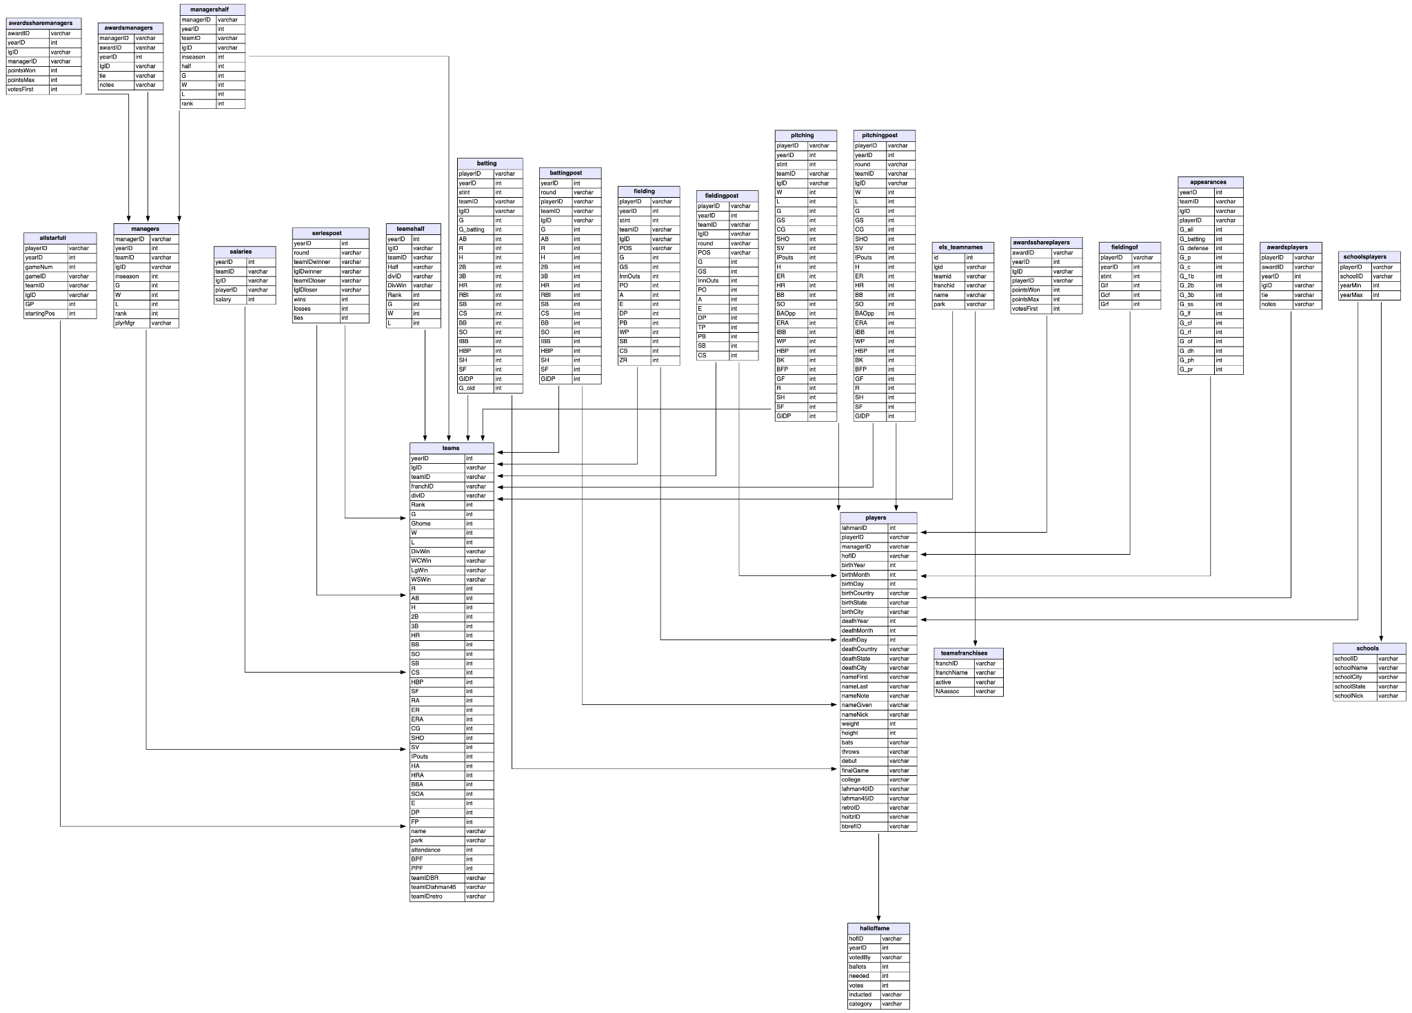
Machine Learning Strategy for OPS Prediction
Adapted prior project for modeling
Previous project predicted the next season’s OPS from 2001-2016, this project predicted next season’s OPS from 2001-2022
Data was obtained from the Lahman Baseball Database
Used the prior 5 season’s offensive counting statistics, the previous season’s postseason offensive counting statistics, and the previous season’s team, primary position, and awards as the features for the model
Analyzed several regression models to see which was most accurate on the training dataset, then evaluated on the training dataset
Image from: https://relational.fit.cvut.cz/dataset/Lahman

Slide 5
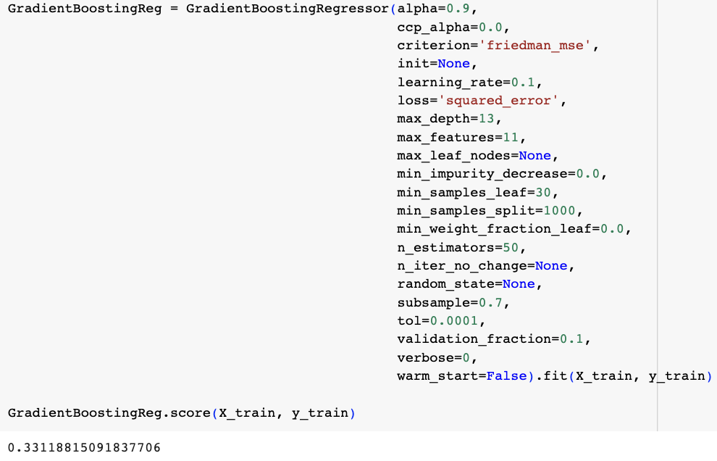
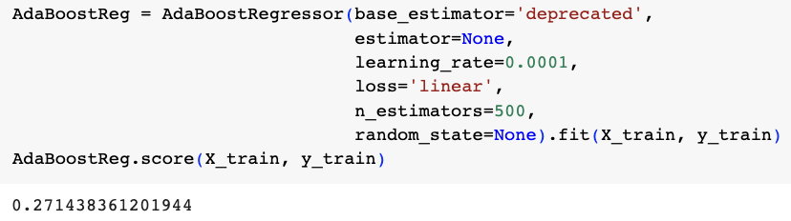
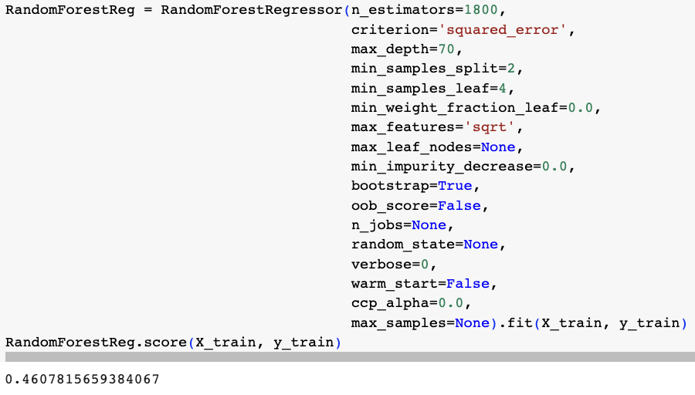
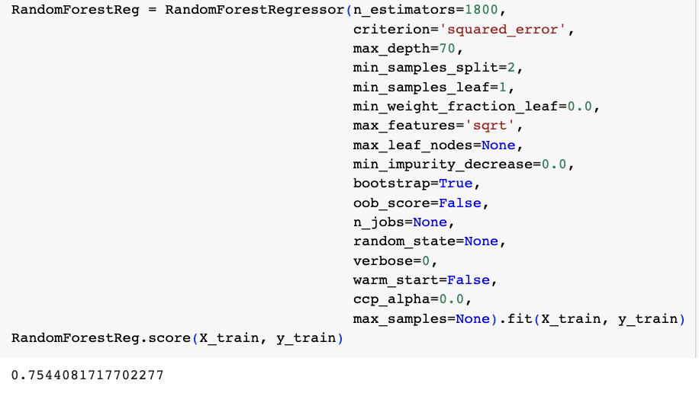
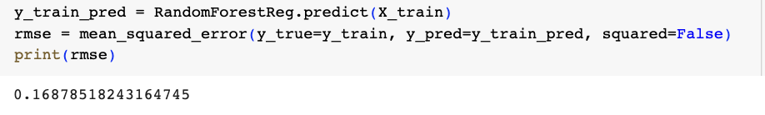
Model Selection
Analyzed three different tree-based regression models: GradientBoostingRegressor, AdaBoost, RandomForestRegressor
Performed hyperparameter tuning for each method to find the most effective version of each model
Evaluated which model to use by finding R² scores for each
Initial tuning and analysis found the RandomForestRegressor to be most effective on the training data at an R² score of 0.461, but further parameter tuning got the model to an R² score of 0.754 with an RMSE of 0.169

Slide 6
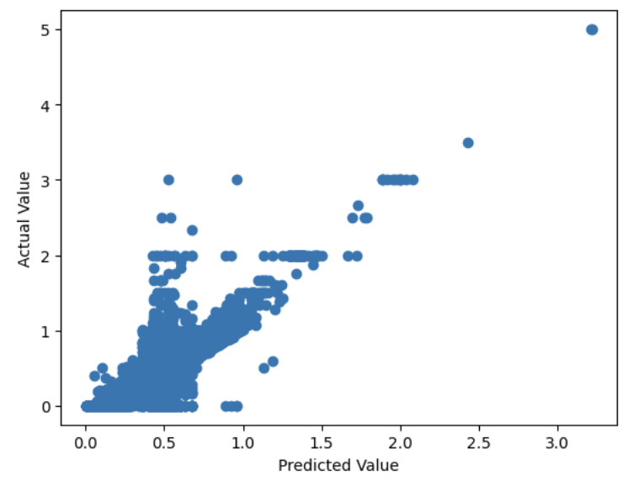
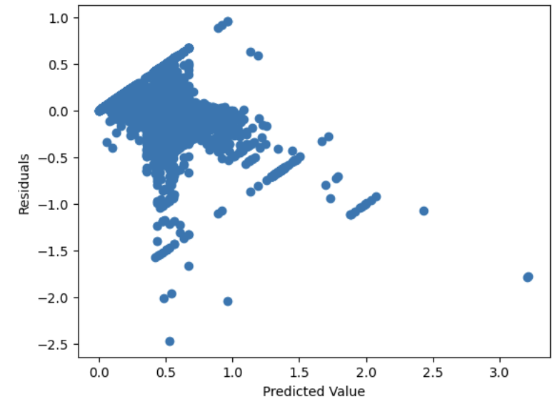
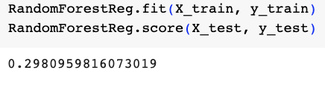
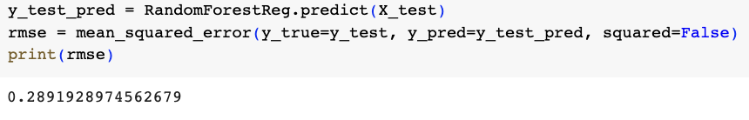
Final Model Evaluation
Investigated y_pred vs y_train along with residuals plot
Noticed evidence of uncaptured exploratory information in the residuals
Evaluation of test data showed that the model did not have predictive validity, with an R² score of 0.298 and a RMSE of 0.289

Slide 7
Conclusions
RandomForestRegressor model had evidence of accurate OPS prediction in the training data, but potential uncaptured exploratory information in the residuals and low accuracy in the test data show the need for further model development
Potential further investigations:
Run model with less features
Run model with more past data

Slide 8
Citations
Birnbaum, P. (n.d.). A Guide to Sabermetric Research: Asking the Right Questions . Society for American Baseball Research. https://sabr.org/sabermetrics/asking-right-questions
On base percentage - BR Bullpen. (n.d.). Baseball Reference. https://www.baseball-reference.com/bullpen/On_base_percentage
Sabermetrics - BR Bullpen. (n.d.). Baseball Reference. https://www.baseball-reference.com/bullpen/Sabermetrics
Slugging percentage - BR Bullpen. (n.d.). Baseball Reference. https://www.baseball-reference.com/bullpen/Slugging_percentage

